Slide 1
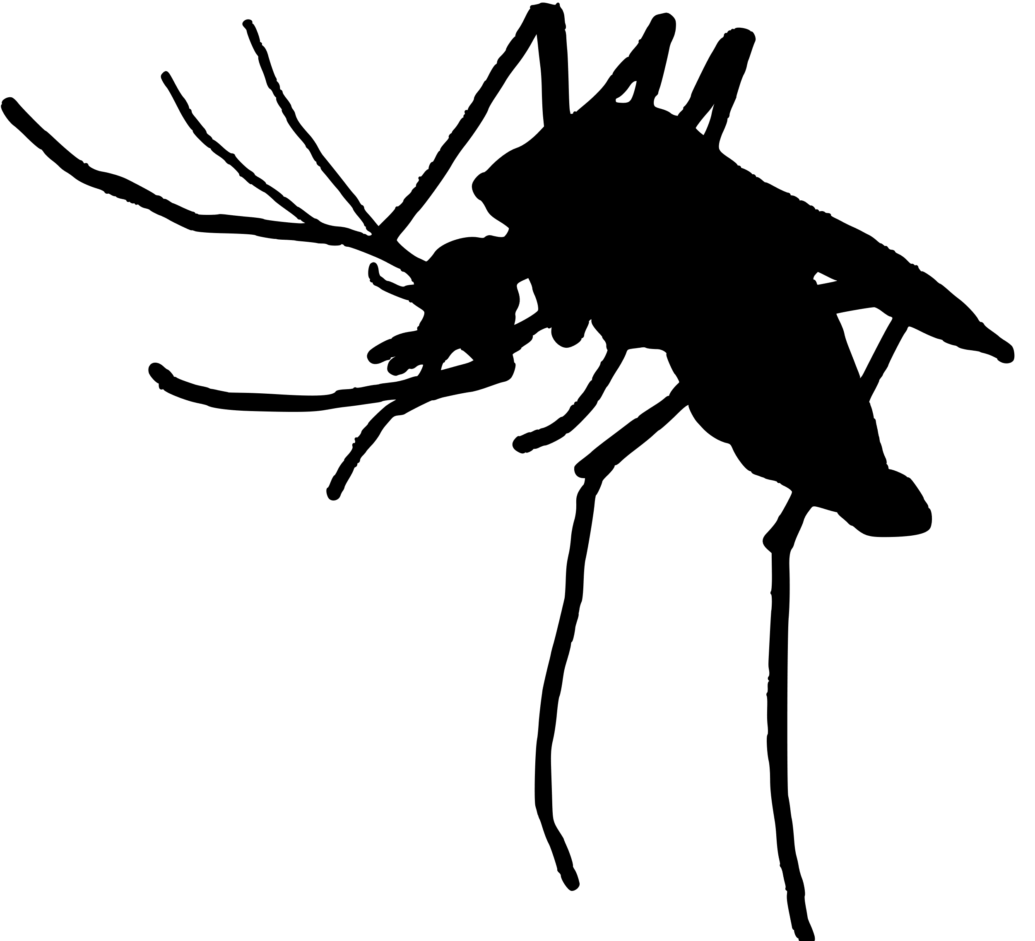
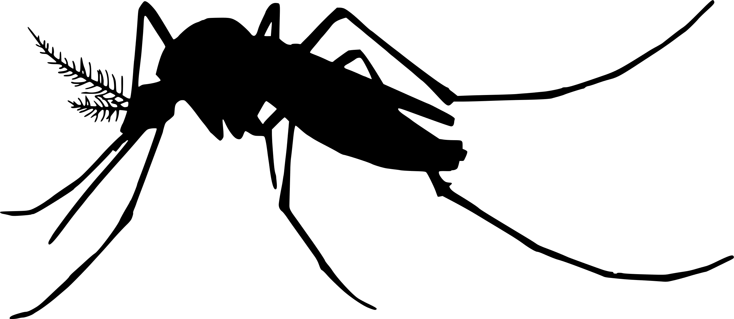
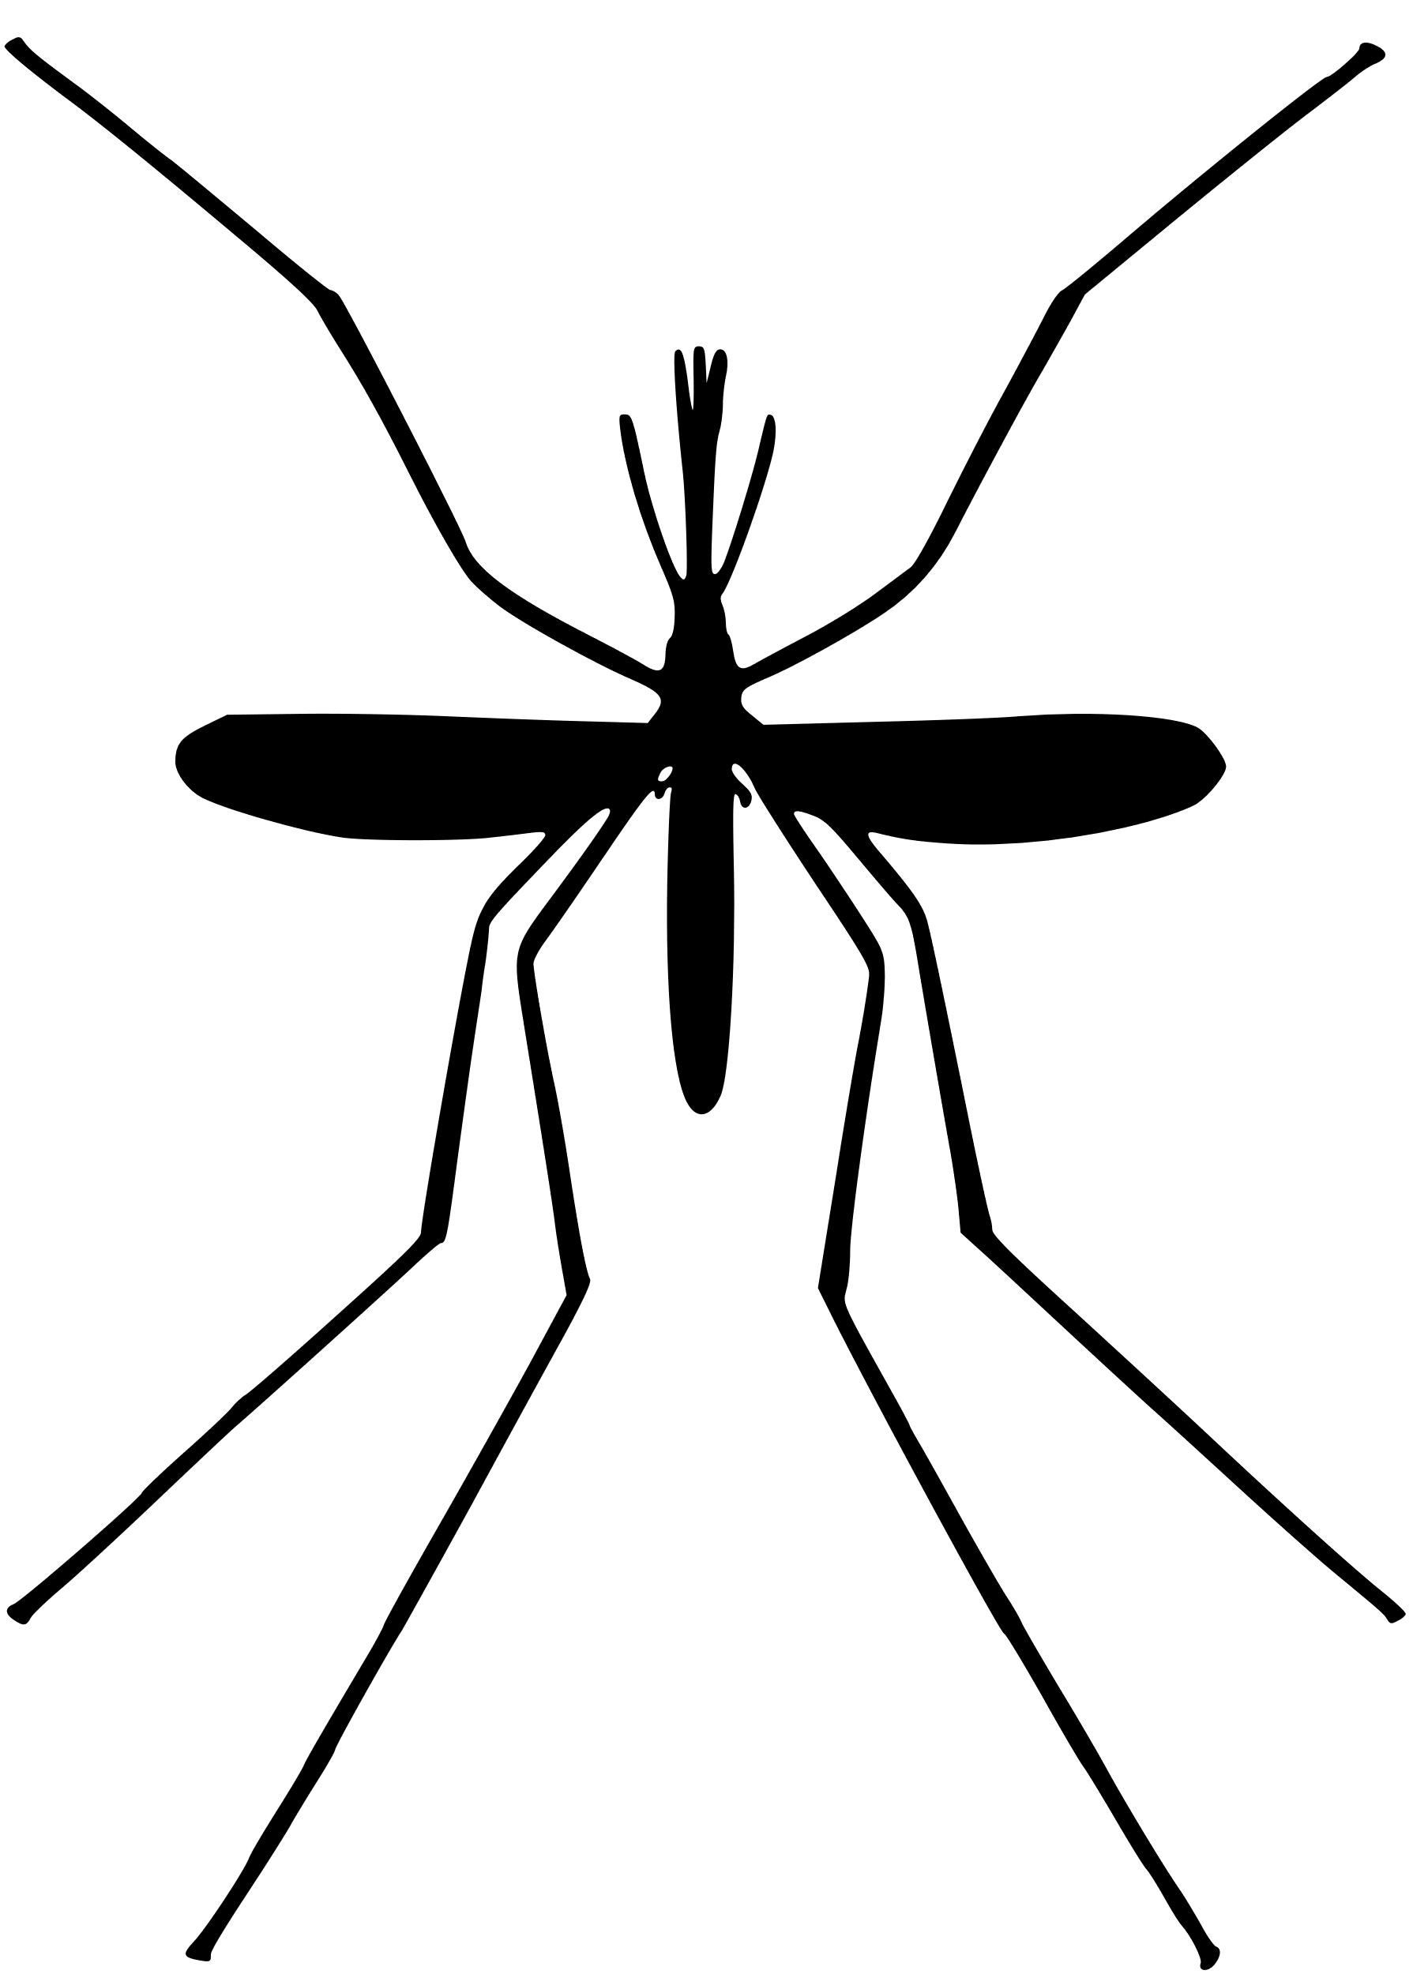

Modeling the mechanisms of mosquito multiple blood-feeding and their effects on disease transmission
Kyle Dahlin, joint with Michael Robert, and Lauren Childs
Virginia Tech, Department of Mathematics
Contact: kyledahlin@vt.edu
ASCEND Fellowship Conference
Nashville, TN

Slide 2
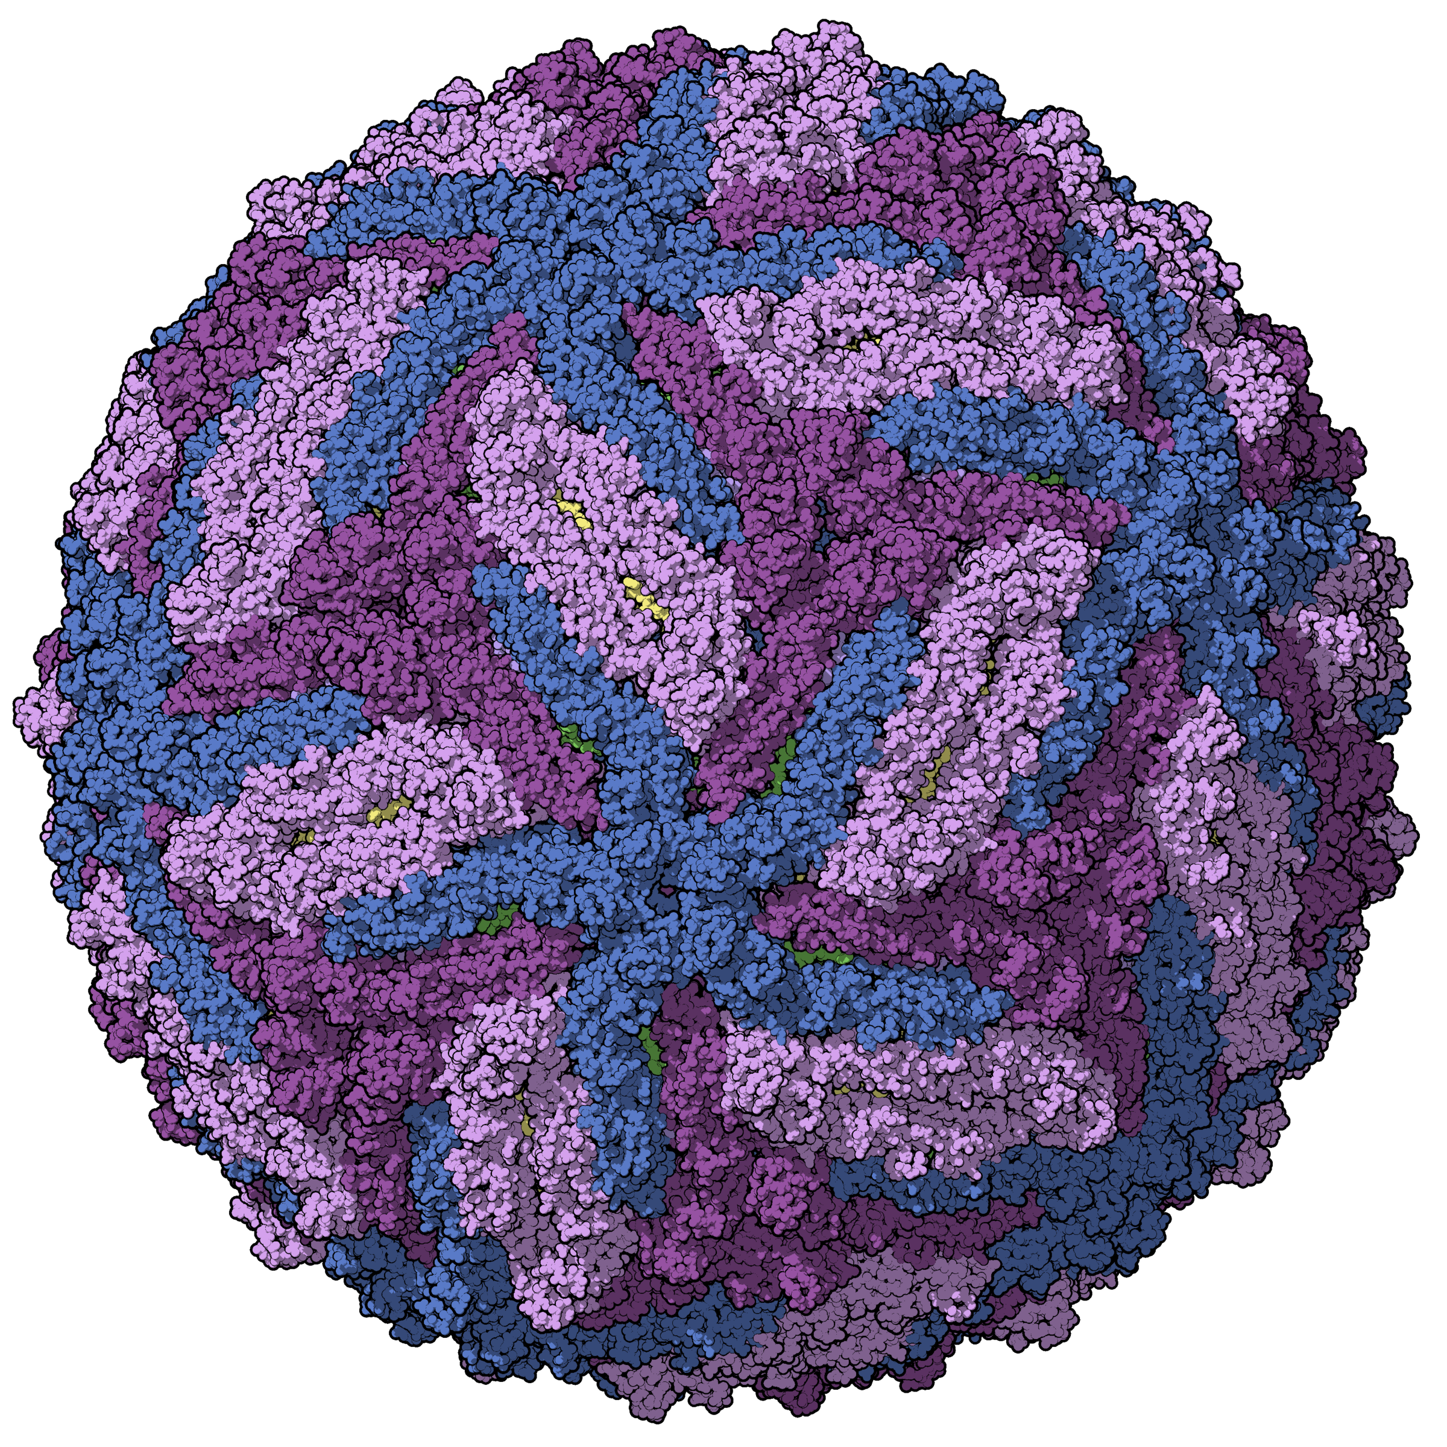
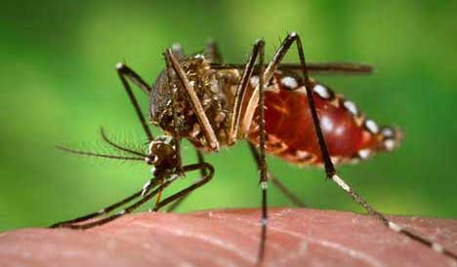
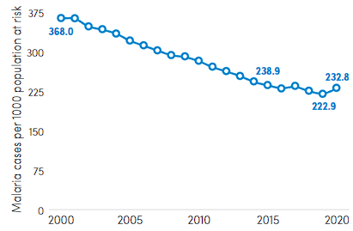
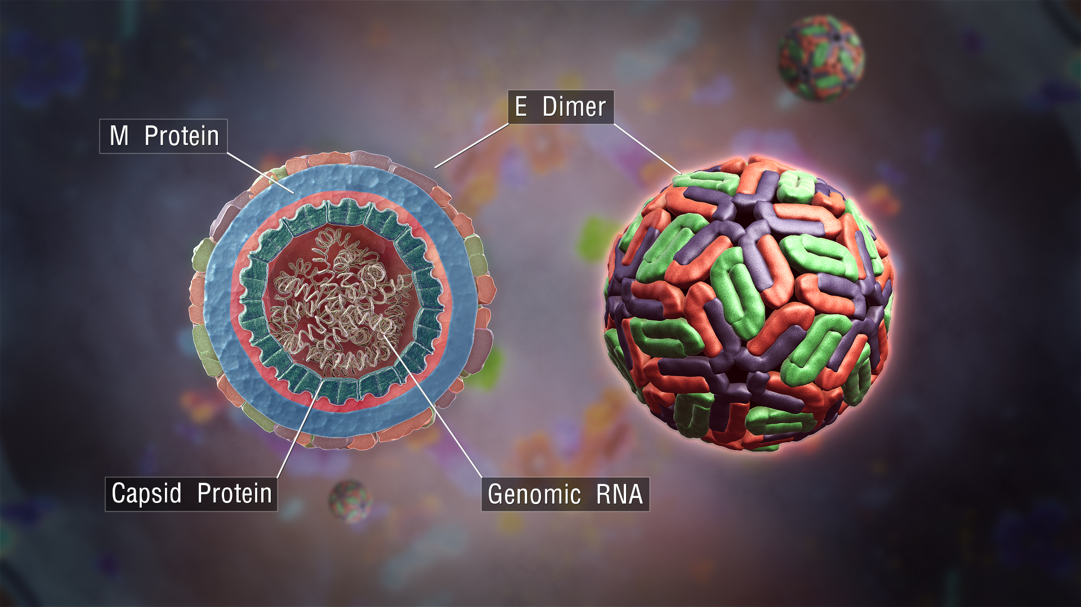
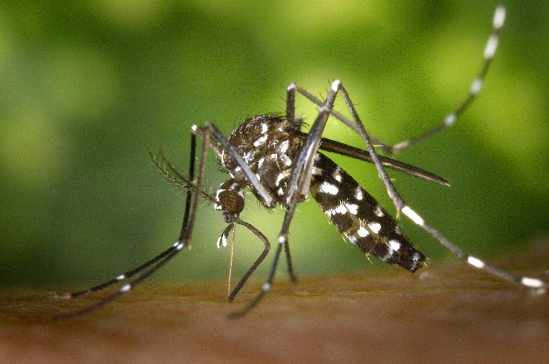
Over 25% of recent emerging disease outbreaks were due to mosquito-borne pathogens (Jones 2008, Gould 2017)
Efforts to eliminate malaria have stalled in recent years
Africa region
Aedes aegypti (CDC.gov)
Zika virus virion
(Manuel Almagro Rivas)
Dengue virus virion (ScientificAnimations.com)
Aedes albopictus (CDC.gov)
Notes:
While we’re all familiar with directly-transmitted diseases like COVID, in actuality over a quarter of recent emerging infectious diseases are due to mosquito-borne pathogens like Zika, Dengue, and Chikungunya.
In addition, malaria, which has been with our species since our inception but continues to have devastating impacts in communities in Africa, has recently seen a stall in progress towards its elimination.
Researchers use a variety of tools to work towards eliminating mosquito-borne disease transmission. I use mathematical models to improve our understanding of specific transmission-related phenomena. What I’ll talk to you about today is multiple blood-feeding.

Slide 3
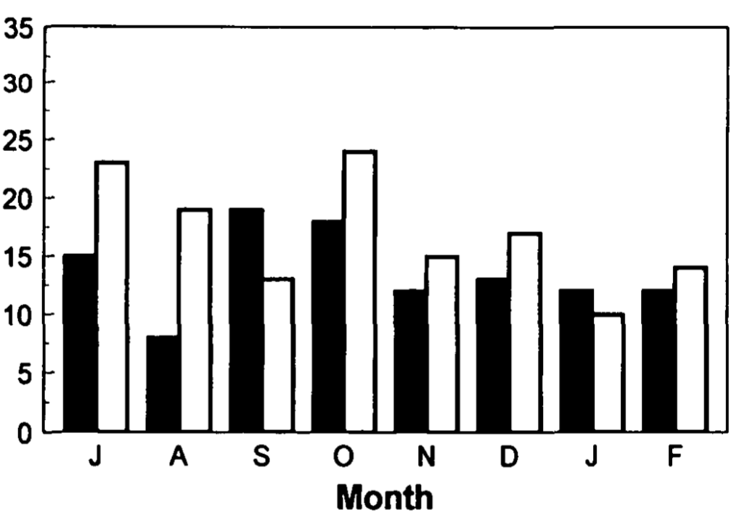
Multiple blood feeding* is common
* feeding more than once in a single reproductive cycle
% of mosquitoes taking > 1 blood meal
Modified from Beier (1996) J Med Entomol
Notes:
Multiple blood feeding = feeding more than once in a single gonotrophic (reproductive) cycle

Slide 4
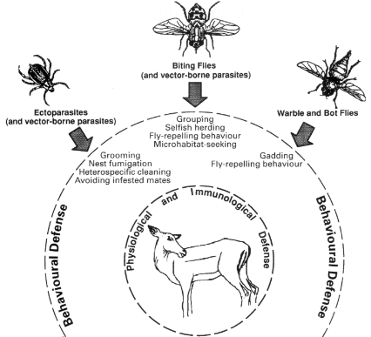
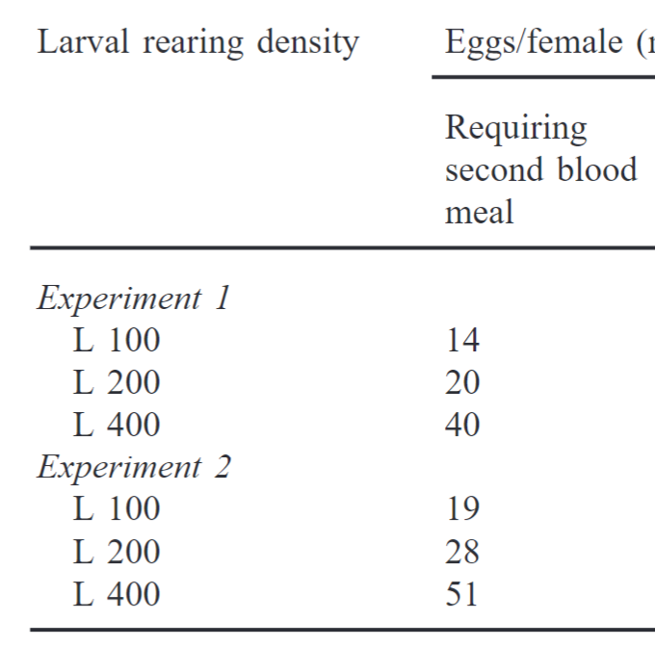
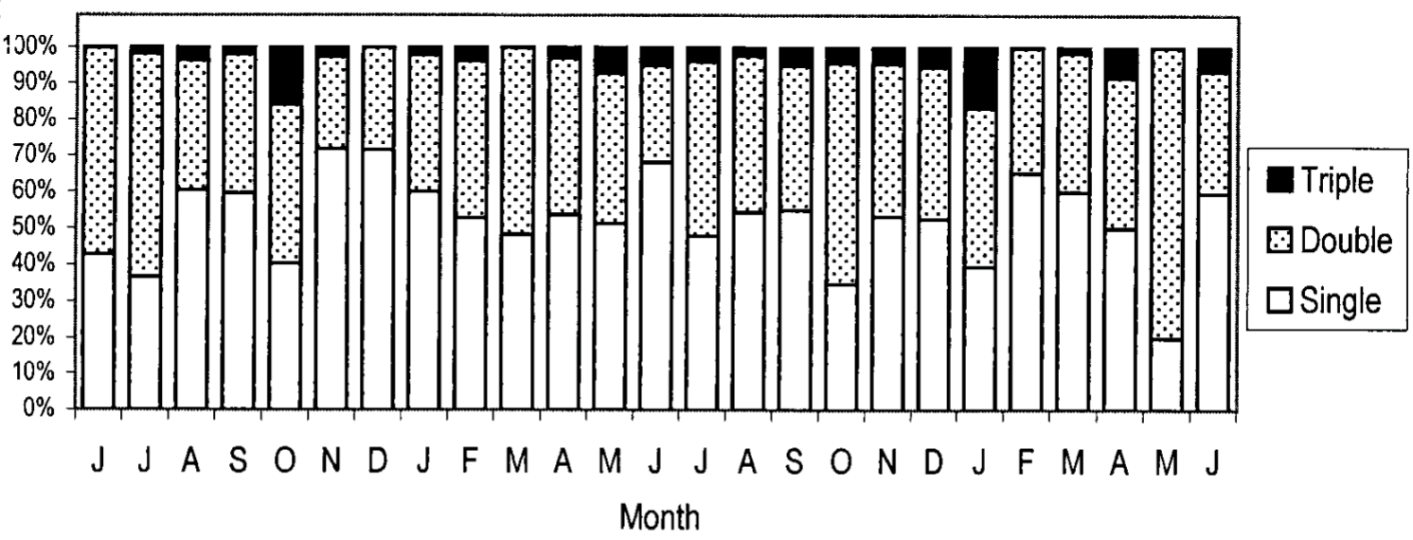
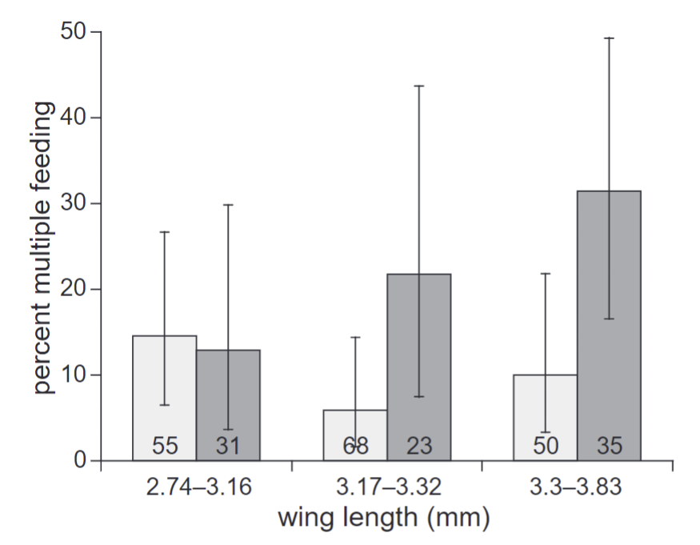
Drivers of multiple blood-feeding
Extrinsic Factors
Intrinsic Factors
Infection status or
body size
Seasonality
Juvenile conditions
Uninfected with malaria
Infected with malaria
Seasonality drives patterns in multiple blood feeding for Aedes aegypti
Modified from Scott et al. (2000) J Med Entomol
Effect of size and infection status (Plasmodium falciparum) on the probability of Anopheles gambiae having multiple blood meals
Modified from Koella, et al (1998) Proc Biol Sci
Ramasamy et al. (2000) J Insect Physiol
Hosts have an array of defensive strategies they can employ to avoid insect blood feeding
Hart (1994) Parasitology

Slide 5
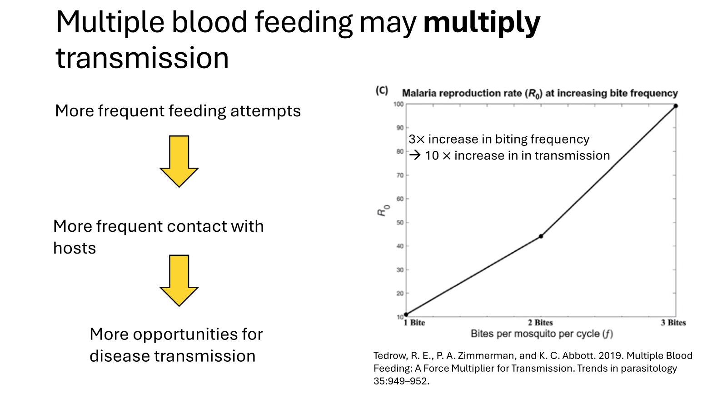

Slide 6

Does multiple blood-feeding always multiply transmission?
Or do the specific drivers matter?
Notes:
To answer this, we need to understand the mechanisms of mosquito blood-feeding

Slide 7

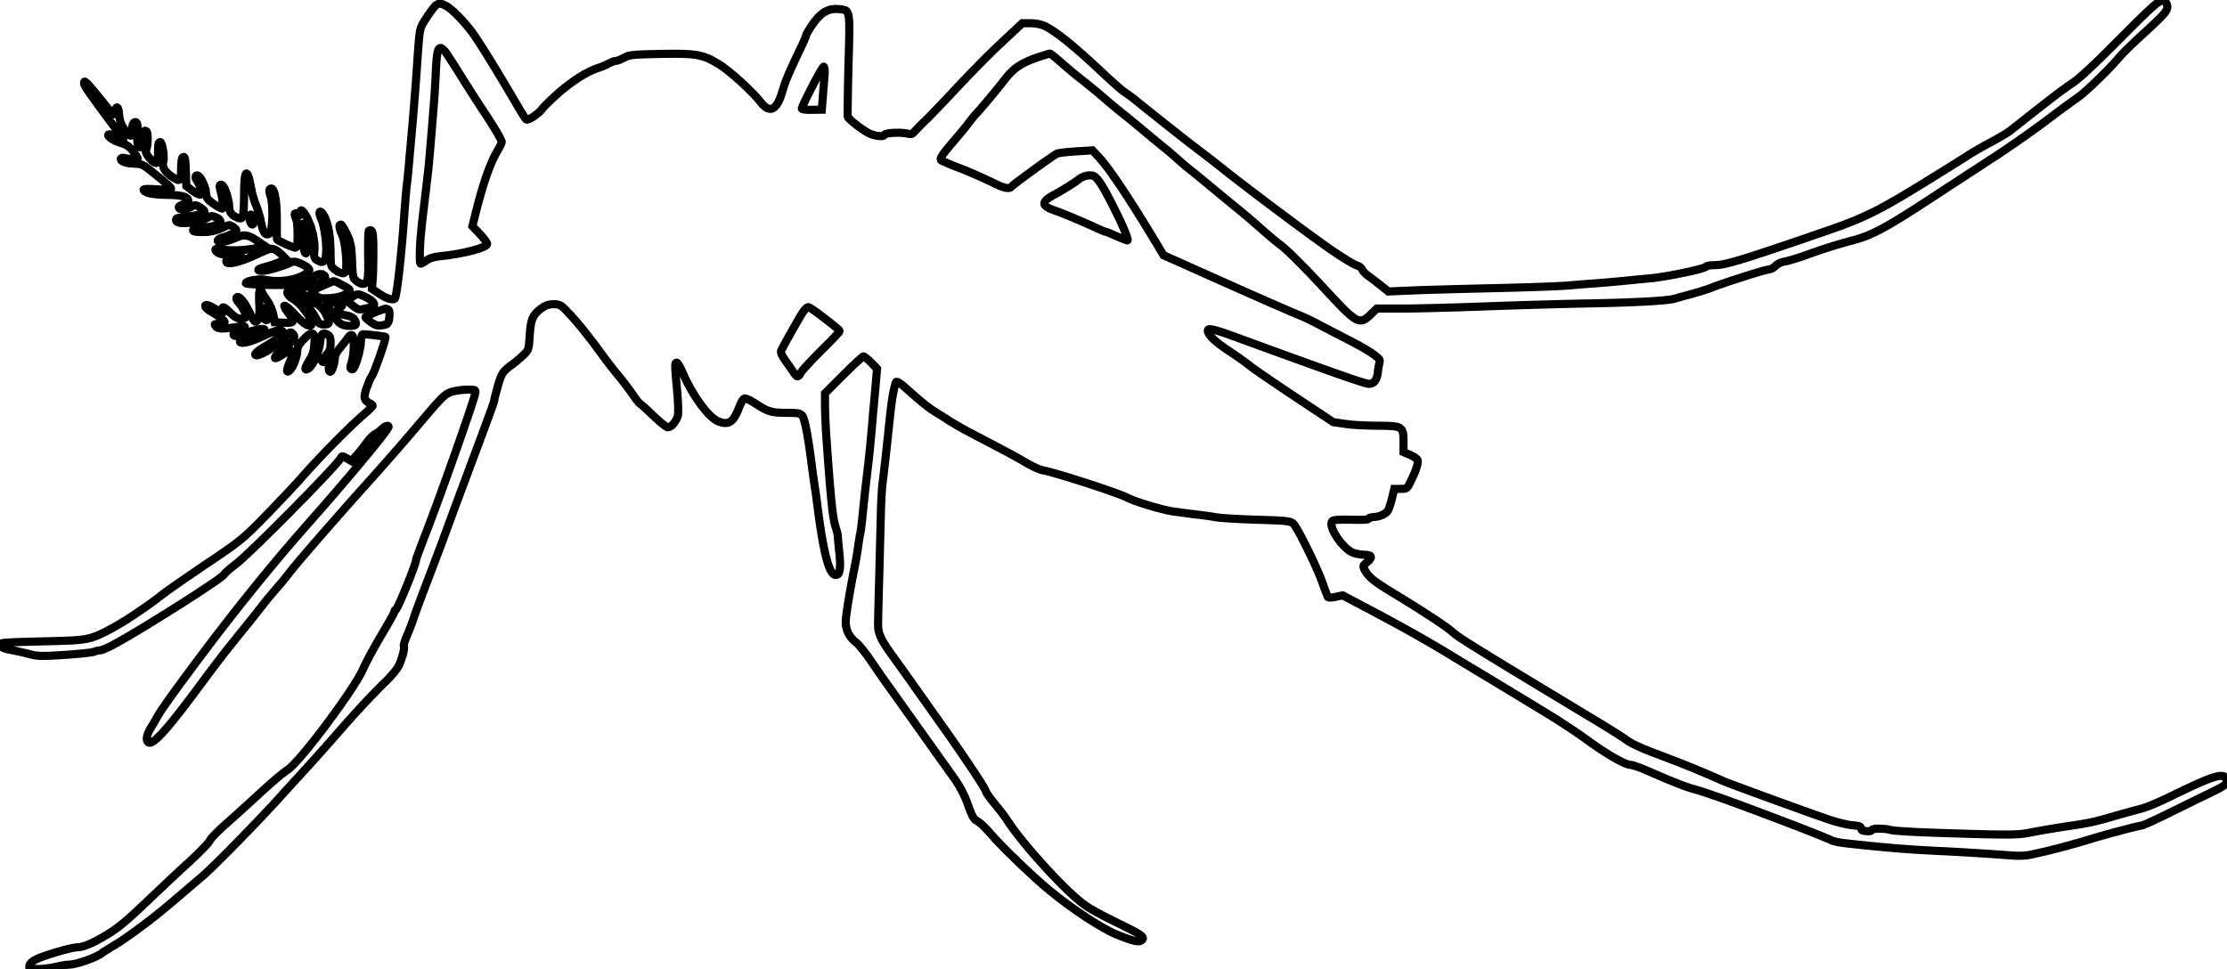
The blood-feeding process
Locate host
“Questing”
“Successful hematophagy culminates in an intricate cascade of events.” – John D. Edman and Andrew Spielman
Landing
Probing
Ingesting
Repletion:
Proceed to oviposition stage

Slide 8
The real blood-feeding process
Locate host
“Questing”
Success
Landing
Transmission to host
Probing
Depart and quest for new host
Failure
Ingesting
Transmission to vector
Repletion:
Proceed to oviposition stage
Persist on same host
Notes:
Maybe: combine probing, salivation, and feeding then break them out later when focusing on transmission

Slide 9

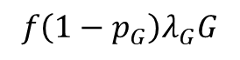
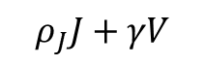

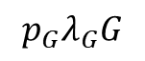
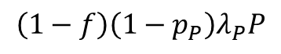
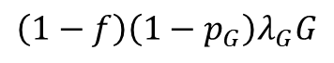
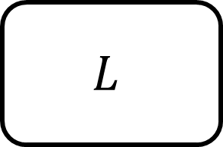
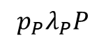

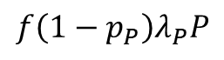
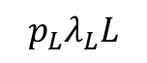
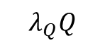
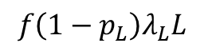
The real blood-feeding process
$$Q$$
$$λ_{Q}Q$$
$$ρ_{J}J+γV$$
Success
$$L$$
$$f\left(1−p_{L}\right)λ_{L}L$$
$$p_{L}λ_{L}L$$
$$P$$
$$\left(1−f\right)\left(1−p_{P}\right)λ_{P}P$$
$$p_{P}λ_{P}P$$
Failure
$$f\left(1−p_{P}\right)λ_{P}P$$
$$G$$
$$p_{G}λ_{G}G$$
$$\left(1−f\right)\left(1−p_{G}\right)λ_{G}G$$
$$f\left(1−p_{G}\right)λ_{G}G$$
Notes:
Maybe: combine probing, salivation, and feeding then break them out later when focusing on transmission

Slide 10
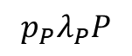
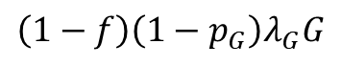


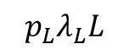
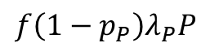
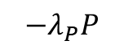
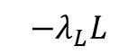
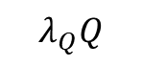
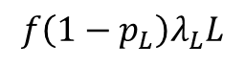
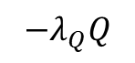
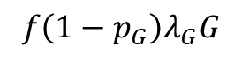
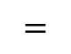
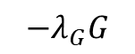
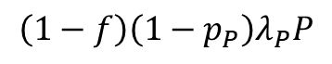
The real blood-feeding process
 |  | $$0$$ | $$0$$
 |  |  | $$0$$
 |  | $$0$$
$$−λ_{Q}Q$$
$$λ_{Q}Q$$
$$f\left(1−p_{L}\right)λ_{L}L$$
$$−λ_{L}L$$
$$p_{L}λ_{L}L$$
$$A$$
$$=$$
$$f\left(1−p_{P}\right)λ_{P}P$$
$$\left(1−f\right)\left(1−p_{P}\right)λ_{P}P$$
$$−λ_{P}P$$
$$p_{P}λ_{P}P$$
$$f\left(1−p_{G}\right)λ_{G}G$$
$$\left(1−f\right)\left(1−p_{G}\right)λ_{G}G$$
$$−λ_{G}G$$
Notes:
Maybe: combine probing, salivation, and feeding then break them out later when focusing on transmission

Slide 11
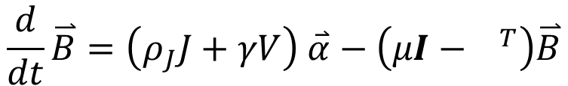

The real blood-feeding process
$$\frac{d}{dt}\overset{⃑}{B}=\left(ρ_{J}J+γV\right) \overset{⃑}{α}−\left(μI−{ }^{T}\right)\overset{⃑}{B}$$
$$A$$
Notes:
Maybe: combine probing, salivation, and feeding then break them out later when focusing on transmission

Slide 12

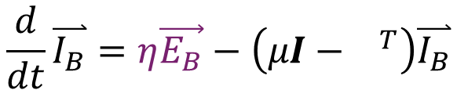
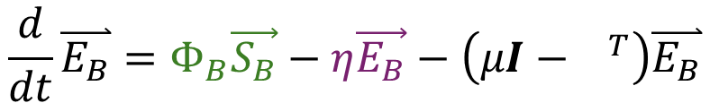


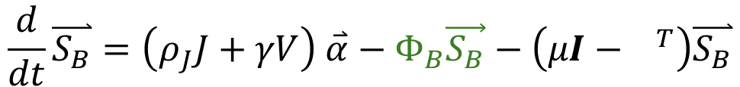
Adding in parasite transmission and development
Susceptible
$$\frac{d}{dt}\overset{⃑}{S_{B}}=\left(ρ_{J}J+γV\right) \overset{⃑}{α}−Φ_{B}\vec{S_{B}}−\left(μI−{ }^{T}\right)\overset{⃑}{S_{B}}$$
$$A$$
Exposed
$$\frac{d}{dt}\overset{⃑}{E_{B}}=Φ_{B}\vec{S_{B}}−η\vec{E_{B}}−\left(μI−{ }^{T}\right)\overset{⃑}{E_{B}}$$
$$A$$
Infected
$$\frac{d}{dt}\overset{⃑}{I_{B}}=η\vec{E_{B}}−\left(μI−{ }^{T}\right)\overset{⃑}{I_{B}}$$
$$A$$
Notes:
Maybe: combine probing, salivation, and feeding then break them out later when focusing on transmission

Slide 13
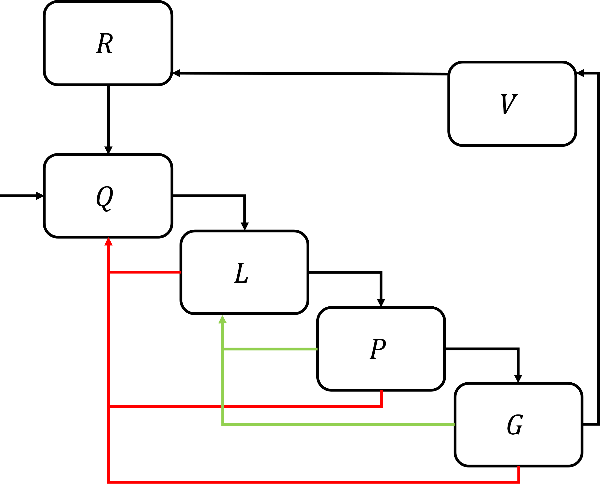
Mosquito population
Susceptible
Exposed
Infectious
Exposure
Pathogen development
Host population
Recovered
Infected
Susceptible

Slide 14
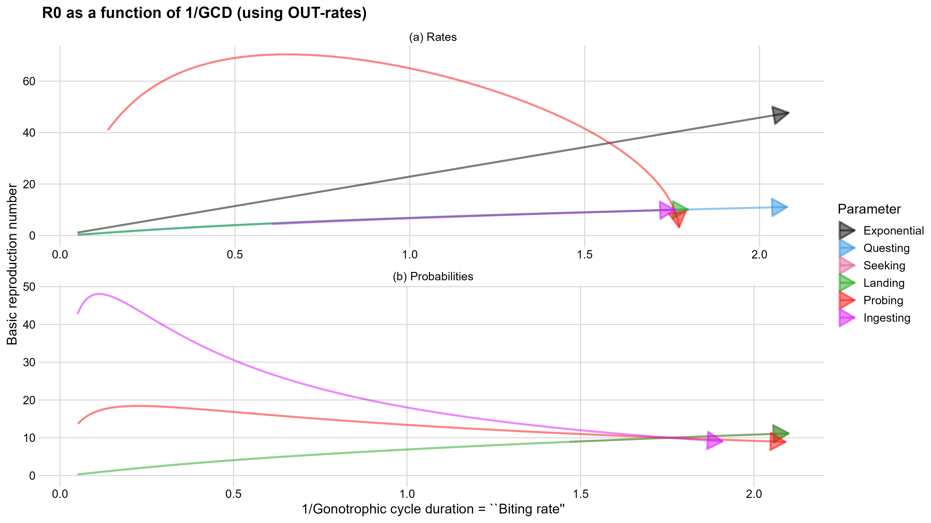
Baseline model linear relationship

Slide 15




Thank you!
Joint work with colleagues at Virginia Tech:
Lauren M. Childs
Associate Professor
Department of Mathematics
Michael Robert
Assistant Professor
Department of Mathematics
Contact: kyledahlin@vt.edu
@kjmd.bsky.social
https://sites.google.com/view/kyledahlin
This work supported by NSF DMS Award # 2316455

Slide 16
Parameter name | Value | Type
Mosquito lifespan | 20 days | Mosquito life history trait
Oviposition & resting period | 2 days | Mosquito life history trait
Eggs per female per day | 3 eggs per day | Mosquito life history trait
Larval development period | 12 days | Mosquito life history trait
Larvae survival probability | 62.5% | Mosquito life history trait
Larvae carrying capacity | 3000 individuals | Mosquito life history trait
Extrinsic incubation period | 6 days | Parasite trait
Host-to-vector transmission probability | 100% | Parasite trait
Vector-to-host transmission probability | 100% | Parasite trait
Host infectious period | 7 days | Parasite trait
Host lifespan | 65 years | Host life history trait
Host carrying capacity | 10^7 individuals | Host life history trait
Notes:
Table of baseline parameter values

Slide 17
Parameter name | Type | Value
Questing rate | Blood-feeding | 1/(480 minutes)
Seek-new-host probability | Blood-feeding | 66%
Landing success probability | Blood-feeding | 70%
Exit rate from landing stage | Blood-feeding | 1/(10 minutes)
Probing success probability | Blood-feeding | 80%
Exit rate from probing stage | Blood-feeding | 1/(5 minutes)
Ingestion success probability | Blood-feeding | 90%
Exit rate from ingestion stage | Blood-feeding | 1/(1 minutes)
Mosquito mortality rate | Mosquito life history trait | 1/(20 days)
Exit rate from oviposition & resting | Mosquito life history trait | 1/(2 days)
Average # eggs per female per day | Mosquito life history trait | 3
Larval development rate | Mosquito life history trait | 1/(12 days)
Larvae survival probability | Mosquito life history trait | 62.5%
Larvae carrying capacity | Mosquito life history trait | 3000
Extrinsic incubation rate | Parasite trait | 1/(6 days)
Host-to-vector transmission prob. | Parasite trait | 100%
Vector-to-host transmission prob. | Parasite trait | 100%
Host infectious period | Parasite trait | 7 days
Host mortality rate | Host life history trait | 1/(65 years)
Host carrying capacity | Host life history trait | 10^7 individuals
Notes:
Table of baseline parameter values

